Slide 1
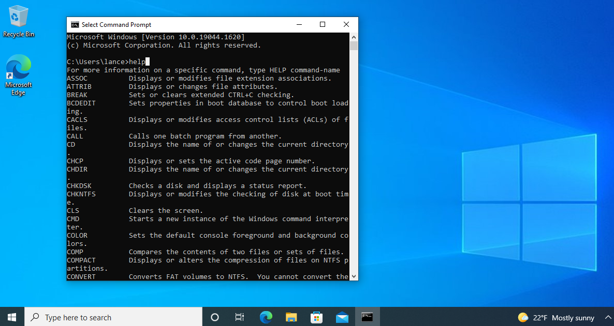

Process CMD Commands in Windows 11 for Testing
Essential Commands for Process Management and Testing

Slide 2


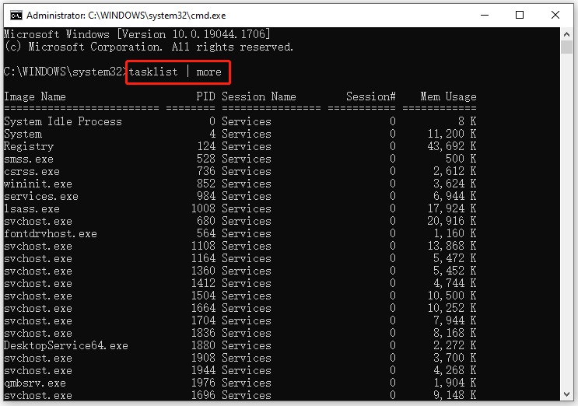


Introduction to Process Management in Windows 11
What are Processes?
Running instances of applications and system services
Each process has unique Process ID (PID) and resource allocation
Why Important for Testing?
Monitor resource usage during application testing
Identify and terminate unresponsive or resource-intensive processes
CMD Commands Benefits
Lightweight - Works when GUI tools fail
Scriptable - Automate process testing workflows

Slide 3




Key Process CMD Commands Overview
tasklist
taskkill
Displays running processes with PID, memory usage, and session information
Terminates processes by name or PID, with force option for unresponsive programs
wmic process
netstat -ano
Windows Management Instrumentation tool for detailed process information and management
Shows network connections with associated process IDs for network troubleshooting

Slide 4


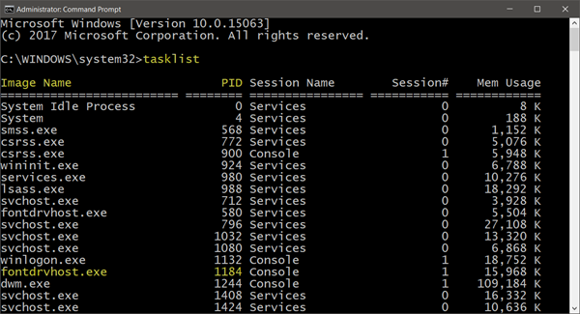
Tasklist Command - Syntax and Examples
Syntax
Basic Usage
tasklist [/s [/u \ [/p ]]] [/m | /svc | /v] [/fo [/nh]] [/fi ]
tasklist
tasklist /v
tasklist /svc
Key Parameters
/m
List processes using specified module
/svc
List services for each process
Filtering Examples
/v
Display verbose information
tasklist /fi "imagename eq notepad.exe"
/fo
Output format: TABLE, LIST, CSV
/fi
Filter processes by criteria
tasklist /fi "memusage gt 100000"
tasklist /fi "status eq running"

Slide 5
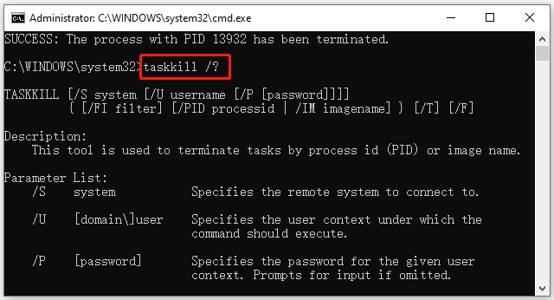
Taskkill Command - Syntax and Examples
Syntax
Basic Usage
taskkill [/s [/u \ [/p ]]] {[/fi ] [/pid | /im ]} [/f] [/t]
taskkill /im notepad.exe
taskkill /pid 1234
taskkill /f /im chrome.exe
Key Parameters
/f
Forcefully terminate process
/im
Kill process by image name
Advanced Examples
/pid
Kill process by PID
taskkill /f /im "my app.exe" /t
/t
Terminate child processes
/fi
Filter processes by criteria
taskkill /fi "memusage gt 100000"
taskkill /s remote-pc /u admin /p password /im app.exe
Use /f parameter for unresponsive processes

Slide 6



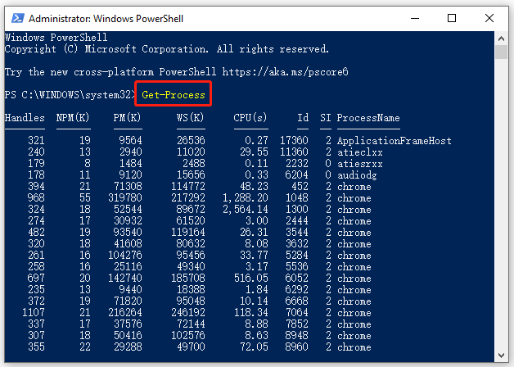
WMIC Command for Process Management
What is WMIC?
Basic Examples
Windows Management Instrumentation Command-line tool
wmic process get Name,ProcessId
Provides detailed system information and management capabilities
More powerful than tasklist for process analysis
wmic process where "Name='notepad.exe'" get ProcessId
Syntax
wmic process get Name,CommandLine,PageFileUsage
wmic process [where condition] get properties
Advanced Examples
Key Properties
wmic process where "WorkingSetSize>10000000" get Name,ProcessId
Name
Process name
ProcessId
Process ID (PID)
wmic process call terminate "notepad.exe"
CommandLine
Command line arguments
WorkingSetSize
Memory usage in bytes
wmic /node:remote-pc process get Name,ProcessId
WMIC is deprecated in Windows 11 and requires manual installation as a "Feature on Demand"
Use /output:filename.txt to save results to file

Slide 7





Advanced Process Testing Techniques
Combining Commands
Pipeline monitoring:
Resource tracking:
Batch termination:
Performance Monitoring
Memory tracking:
Resource logging:
Network connections:
Troubleshooting
Automated Testing
Zombie processes:
Process lifecycle:
Resource hogs:
Stress testing:
Process ancestry:
Batch automation:

Slide 8














Best Practices for Process Testing in Windows 11
Effective Testing
Common Pitfalls
Create baseline before testing
Forgetting /f with unresponsive processes
Log results with timestamps
Not checking privileges before terminating
Test in isolation to avoid interference
Monitor resources during tests
Ignoring child processes when terminating
Using WMIC without checking availability
Resources for Further Learning
Microsoft Docs
PowerShell 7 Guide
Windows Sysinternals
Tech Community
Security Considerations
Performance Tips
Microsoft Learn
Run as admin only when necessary
Filter output to reduce processing time
Verify process identity before termination
Use specific criteria instead of listing all
Avoid exposing sensitive data in logs
Cache results for repeated queries
Use proper authentication for remote systems
Batch operations to reduce overhead

